Slide 1


CAPSTONE PROJECT
Retail Sales Analytics Dashboard using Power BI
Presented By
Student Name: A. MOHAMMED ASSRARULLAH
College Name: B.S. ABDUR RAHMAN CRESCENT INSTITUTE OF SCIENCE AND TECHNOLOGY
Department: B.TECH AIDS
Email ID: azizullahshabeena@gmail.com

Slide 2
OUTLINE:
Problem Statement
Proposed System/Solution
System Development Approach
Algorithm & Deployment
Result
Conclusion
Future Scope
References

Slide 3
Problem Statement:
Retail companies generate large volumes of sales data every day. Without analytical insights, decision makers struggle to answer critical questions such as:
Which products generate the highest revenue?
Which store locations perform well?
What is the sales trend over time?
Which customer segment drives profitability?
Lack of visibility leads to inaccurate forecasting and inefficient business planning.

Slide 4
Proposed Solution:
To address this issue, a Power BI–based Retail Sales Analytics Dashboard is proposed.
The system aims to:
✔ Collect & clean retail sales data
✔ Model necessary business dimensions
✔ Create interactive visual reports
✔ Provide key business insights for decision making
This enables data-driven performance monitoring and strategic planning.

Slide 5
System Approach:
Dataset Used: Retail Sales Transactions (CSV / Excel)
Business Dimensions:
Product
Category
Customer
Store
Time
Tools & Technologies:
Microsoft Power BI
Power Query
DAX (Data Analysis Expressions)
Excel/CSV dataset
Tasks Performed:
Data Import
Data Cleaning & Transformation
Data Modeling
Report & Dashboard Designing
Insights Generation

Slide 6
Algorithm & Deployment:
Data Modeling Approach:
Snowflake Model / Star Schema
Relationships between Fact & Dimension tables
DAX Measures Applied:
Total Sales
Profit
Profit Margin
Sales Growth %
Category-wise Performance
Monthly Trends
Deployment:
Dashboard published to Power BI Service (Optional)
Can be shared with business stakeholders for KPI tracking

Slide 7
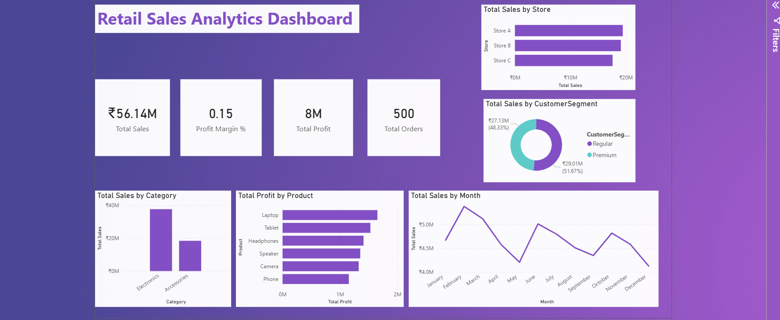
Result:
.

Slide 8
Conclusion:
The project successfully demonstrates the use of Power BI for business analytics.
Interactive dashboards enable decision makers to:
✔ Monitor performance
✔ Identify trends
✔ Improve forecasting
✔ Strengthen business strategies
Thus, Power BI proves to be an effective BI tool for retail analytics.

Slide 9
Future scope:
The solution can be extended by:
➡ Adding forecast models using DAX or ML
➡ Integrating live sales database
➡ Building automated reporting pipelines
➡ Expanding to multiple retail regions
➡ Adding customer churn & lifetime value analytics

Slide 10
References:
Microsoft Power BI Documentation
Dataset (Retail Store) / Kaggle / UCI
Power Query Docs
DAX Function References
GITHUB LINK:
https://github.com/Assrar2007/Retail-Sales-Analytics-Dashboard-using-Power-BI

Slide 11
Thank You

